Slide 1


Parkrun: Access, Participation and Equity
Robert Smith
PhD Candidate, ScHARR
History of Parkrun
Access & Participation in Parkrun
Identifying Optimal Locations for 200 new events
Further Analysis

Slide 2
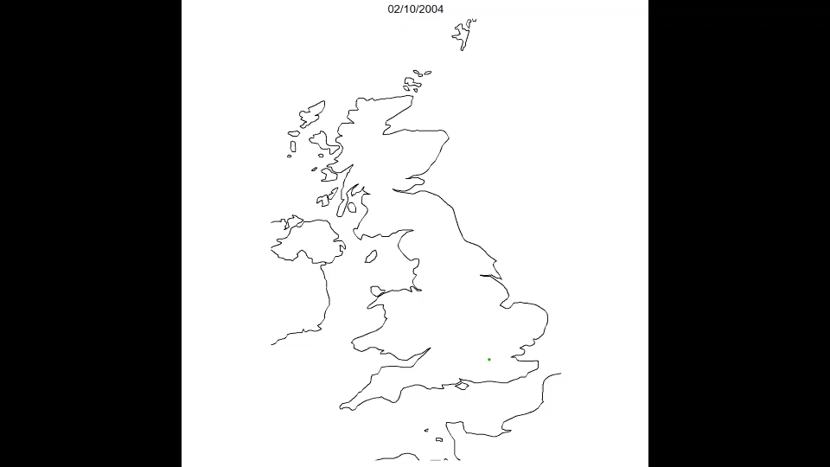
Background
https://www.youtube.com/watch?v=ktx4lujARdc&feature=share
https://www.shu.ac.uk/research/specialisms/advanced-wellbeing-research-centre/our-partners/parkrun

Slide 3
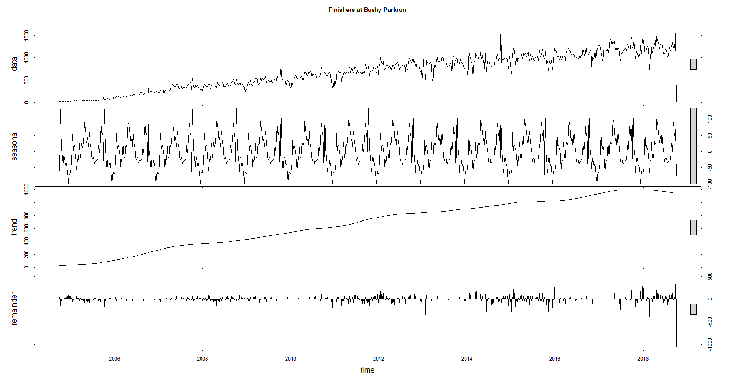
Trends at Bushy Parkrun

Slide 4
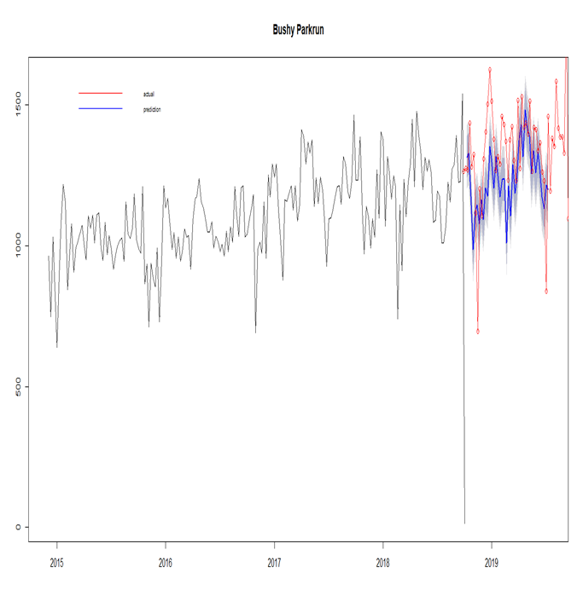
Predicting Attendance at Bushy Parkrun

Slide 5

Background

Slide 6
Research Questions
Where should parkrun locate 200 new parkrun events?
 | Access | Participation
Efficiency | 1. Maximize overall access. | 3. Maximize overall participation.
Equity | 2. Maximize deprivation weighted access. | 4. Maximize deprivation weighted participation.

Slide 7
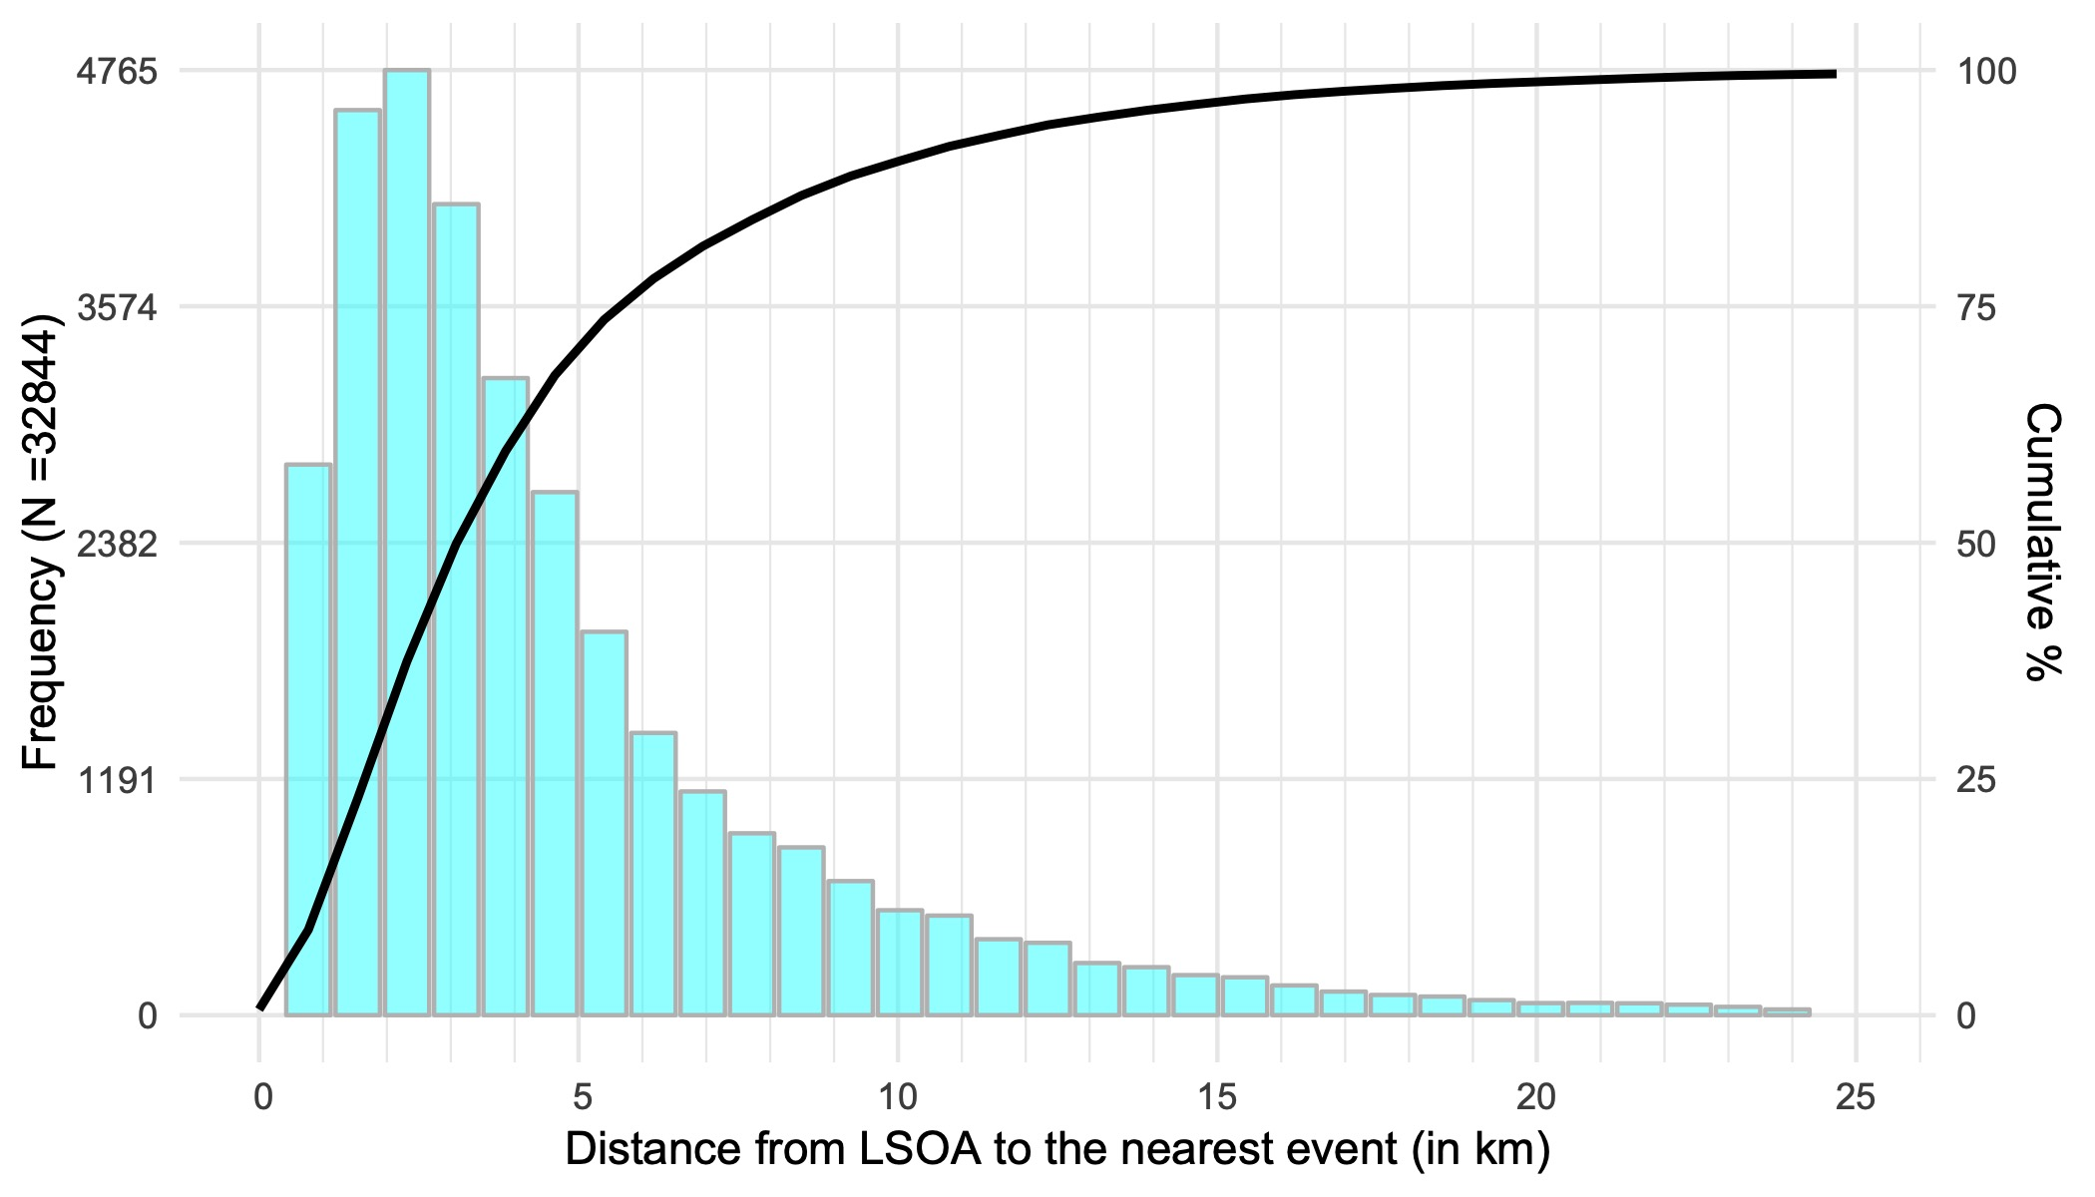
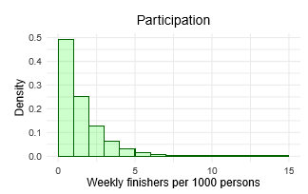
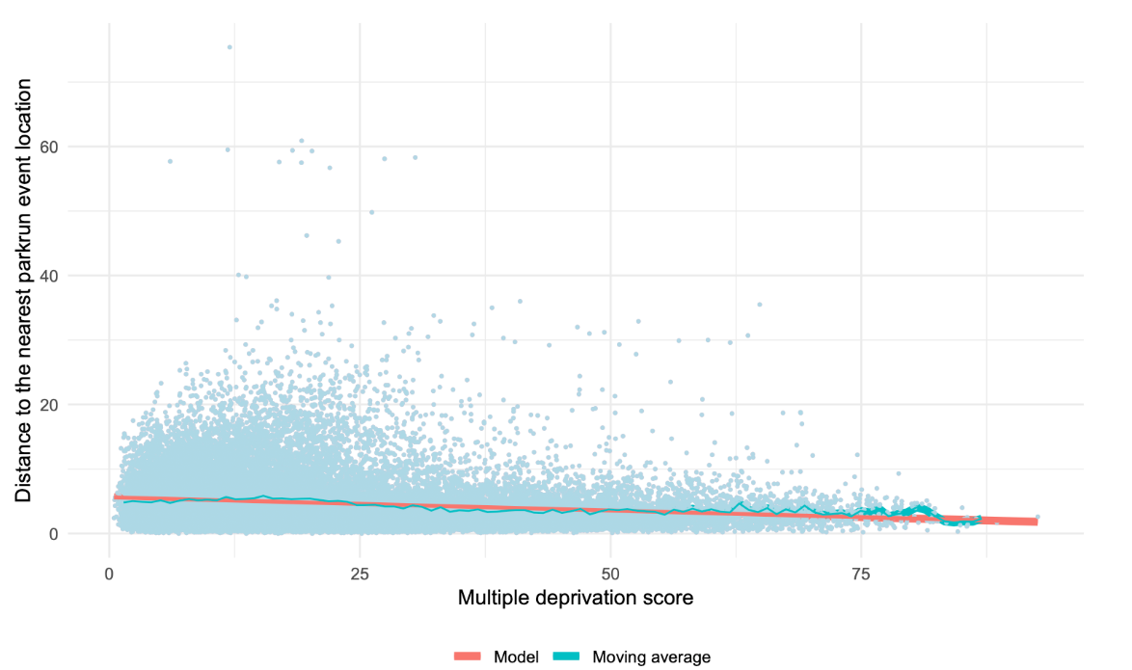
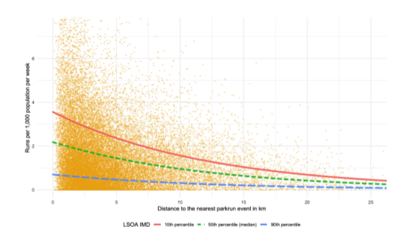
 | Access | Participation
Efficiency
Equity

Slide 8
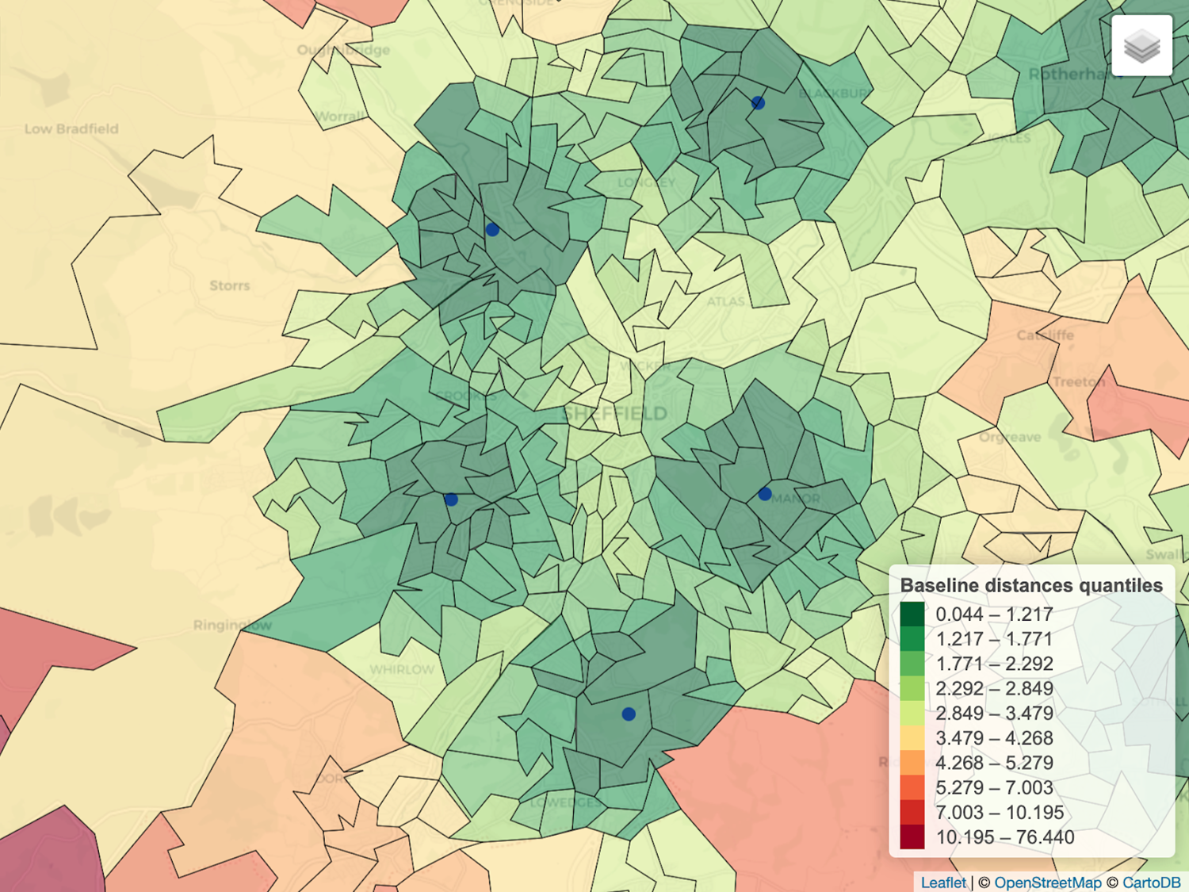

Slide 9
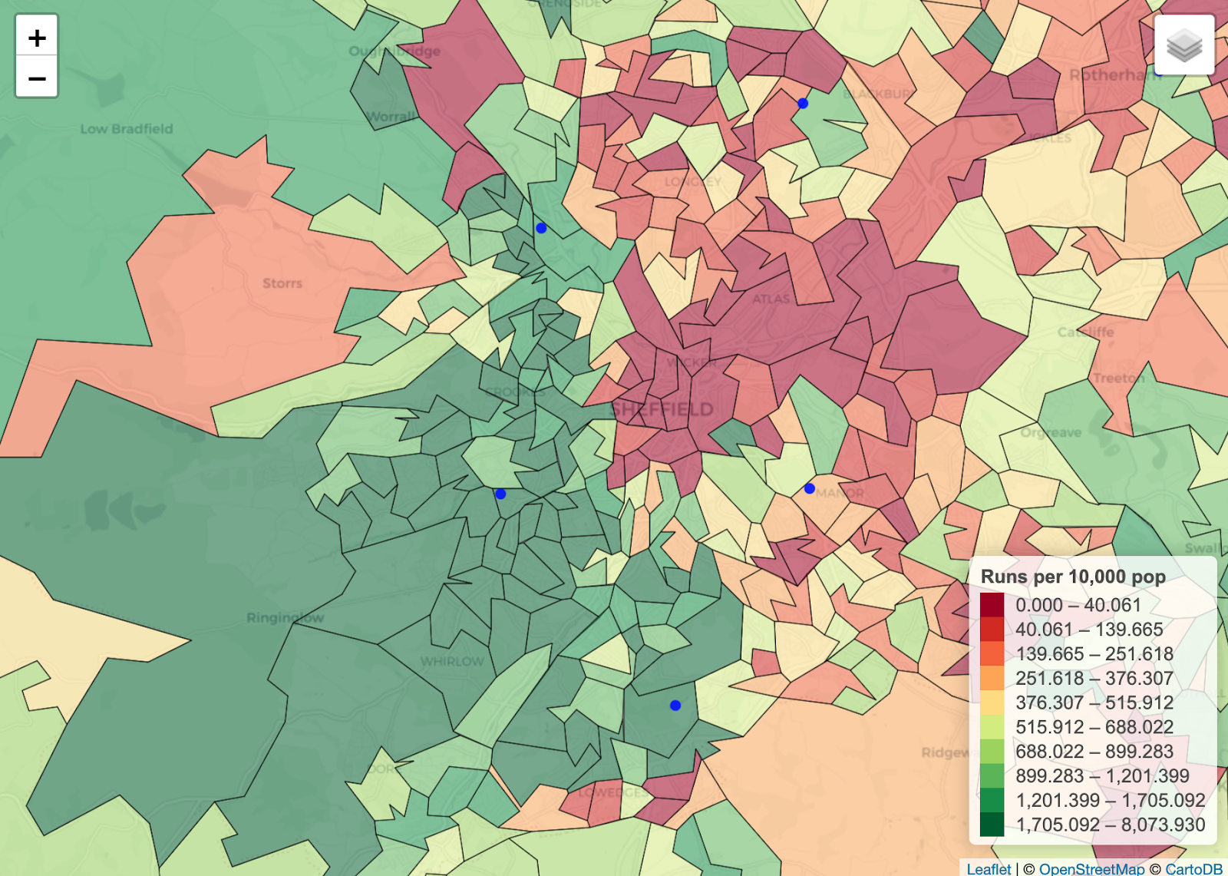

Slide 10
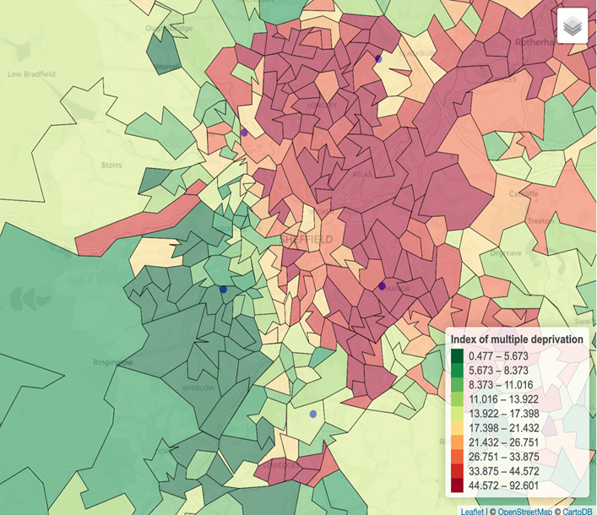

Slide 11
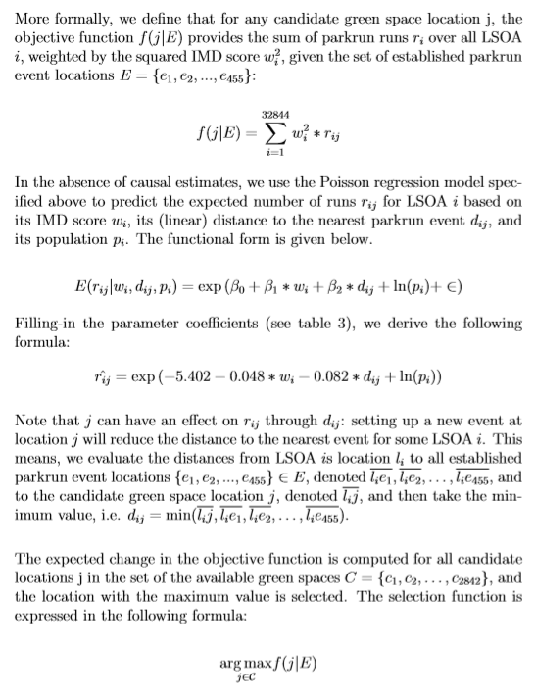
Methods

Slide 12
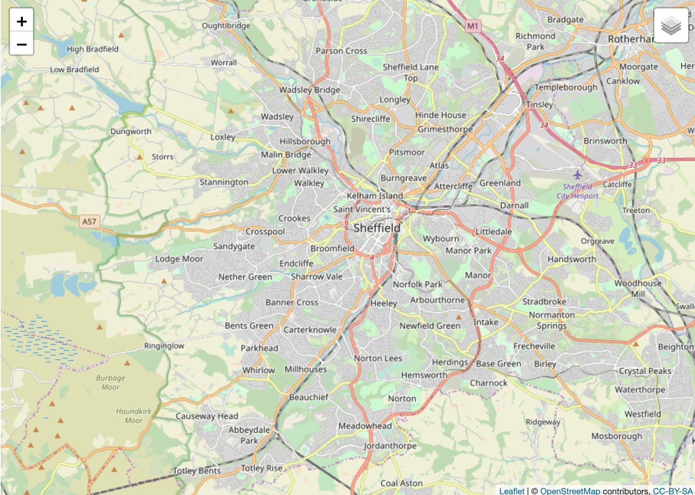

Slide 13
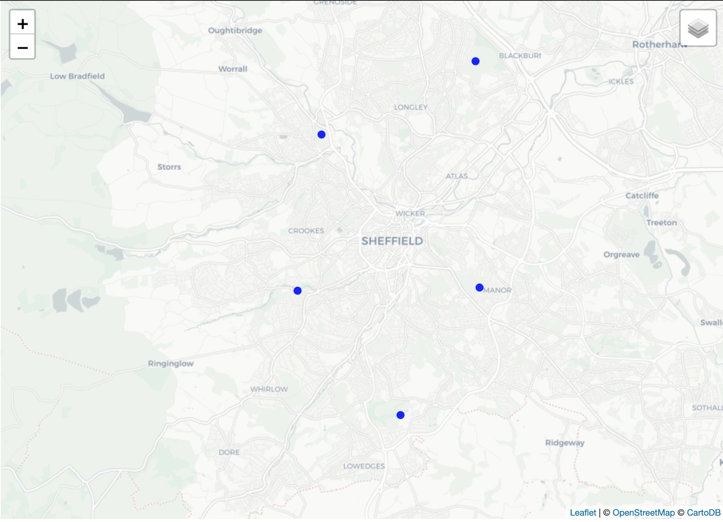

Slide 14
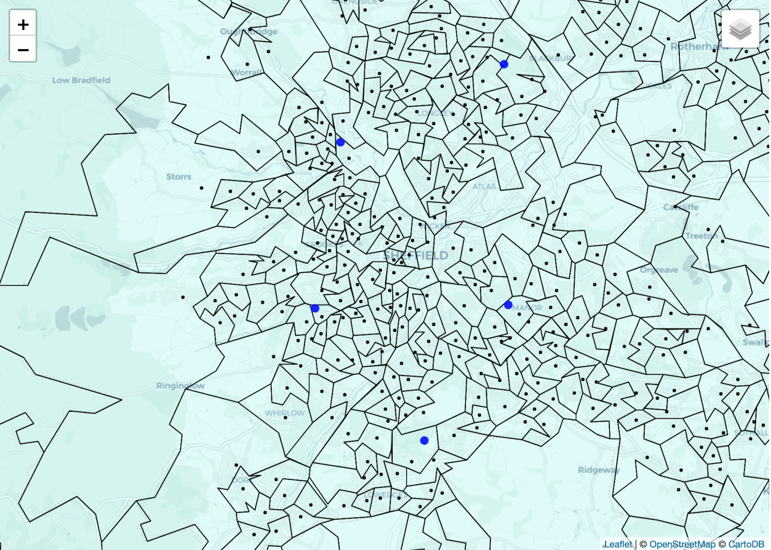

Slide 15
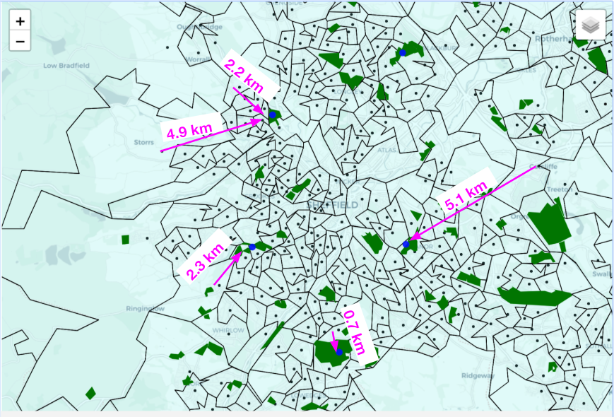
Access = { 2.2 * 1,220 + 4.9 * 2,351+ 2.3*1,915 + 0.7 * 1,844 + 5.1 * 1,530 } = 27,702.2

Slide 16
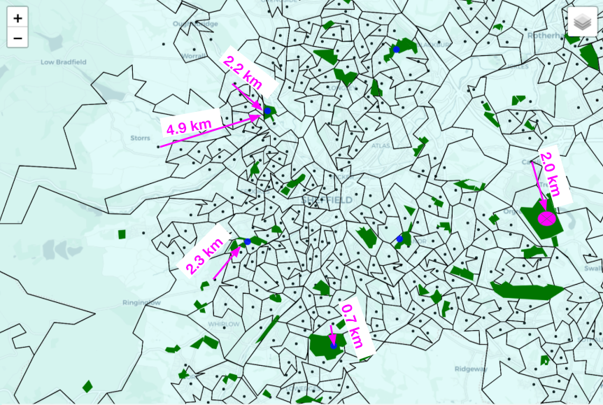
Access = { 2.2 * 1,220 + 4.9 * 2,351+ 2.3*1,915 + 0.7 * 1,844 + 2.0 * 1,530 } = 22,959.2

Slide 17
Results

Slide 18
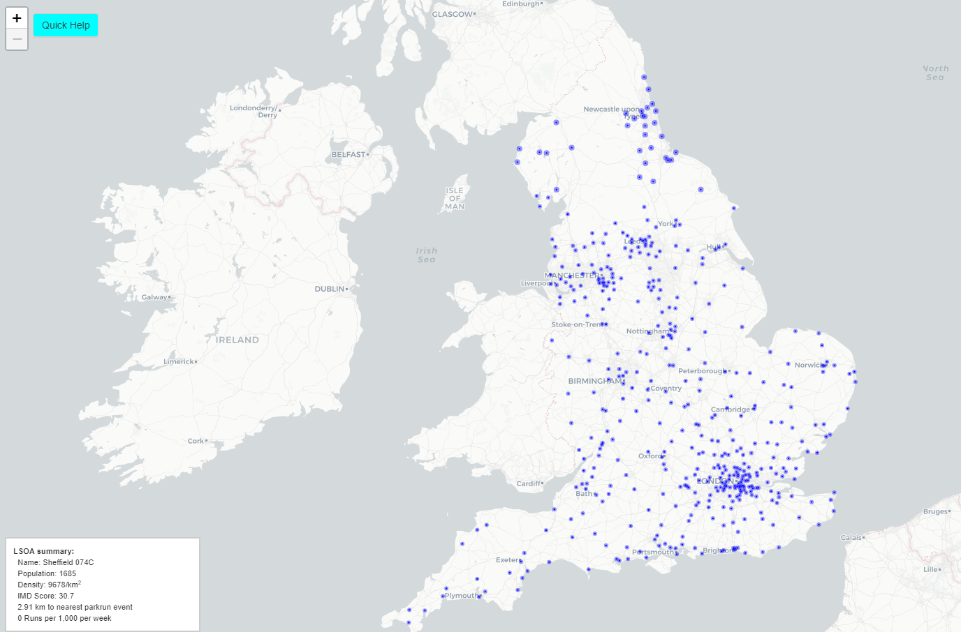
Where should parkrun locate 200 new parkrun events?
https://iolmap.shinyapps.io/parkrun/
http://iol-map.shef.ac.uk/

Slide 19
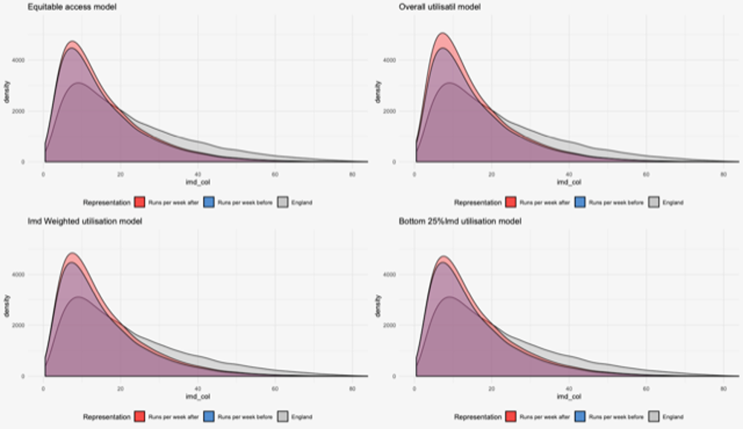
Depressing slide ….

Slide 20
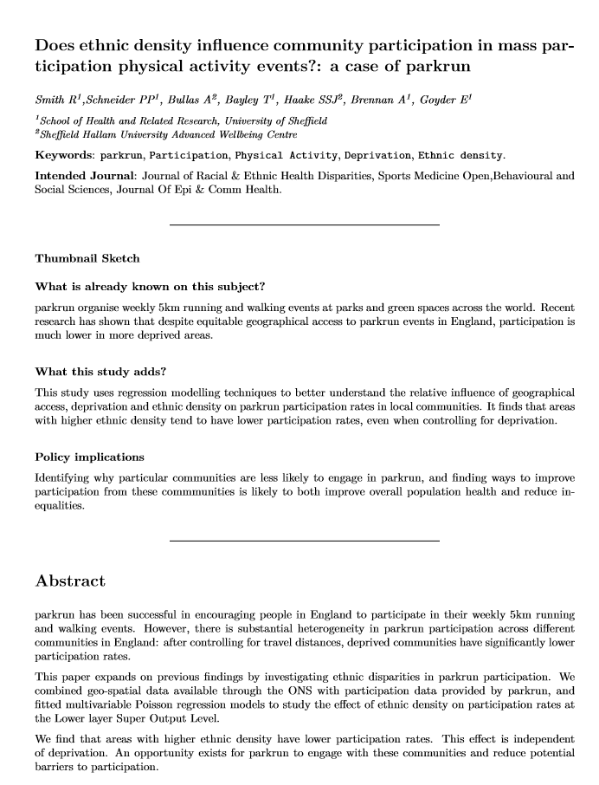
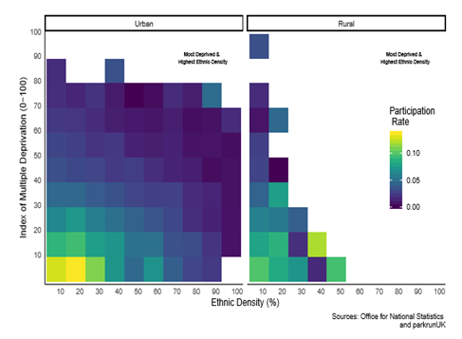
Further Analysis – role of Ethnicity

Slide 21

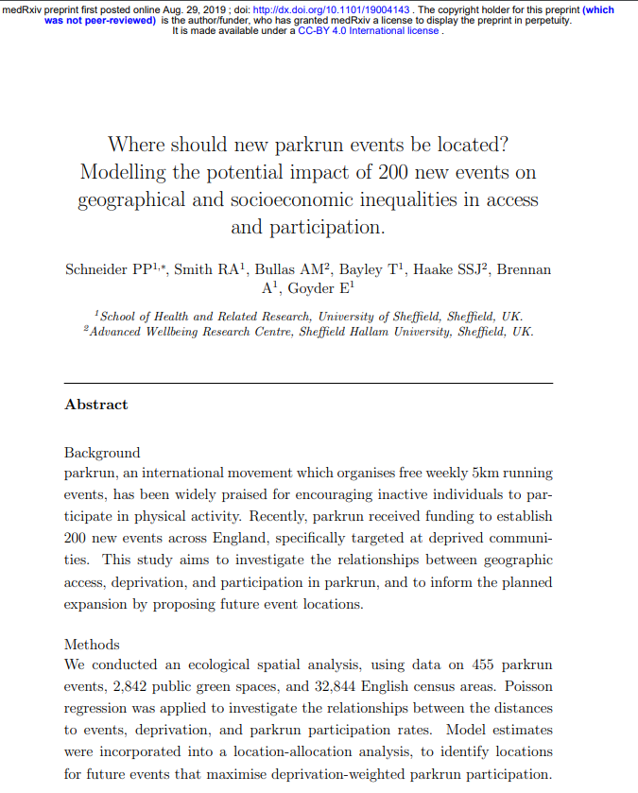
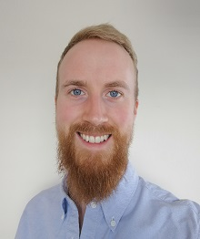




Acknowledgements
Co-authors on pre-print Access & Participation Paper (Attachment 1):
Schneider PP¹, Bullas A², Bayley T¹, Haake SSJ², Brennan A¹, Goyder E¹
Collaborators on conditional probability project (Attachment 2):
Chang J, Schneider PP¹, Brennan A¹, Goyder E¹
Collaborators on the determinants of participation paper:
Schneider PP¹, Bullas A², Haake SSJ², Brennan A¹, Goyder E¹
With special thanks to team at Parkrun Global Wellbeing:
Chrissie Wellington OBE, Rowan Ardill, Tom Mason.
¹School of Health and Related Research, University of Sheffield, Sheffield, UK.
²Advanced Wellbeing Research Centre, Sheffield Hallam University, Sheffield, UK.
³Parkrun Global Health and Wellbeing, ParkrunUK, London.

Slide 22
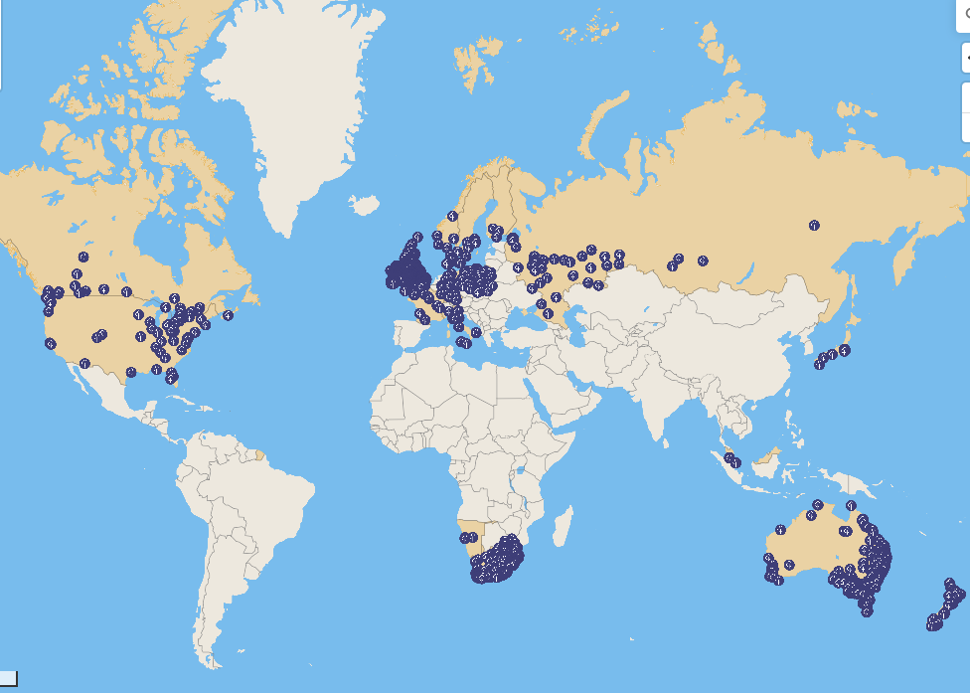
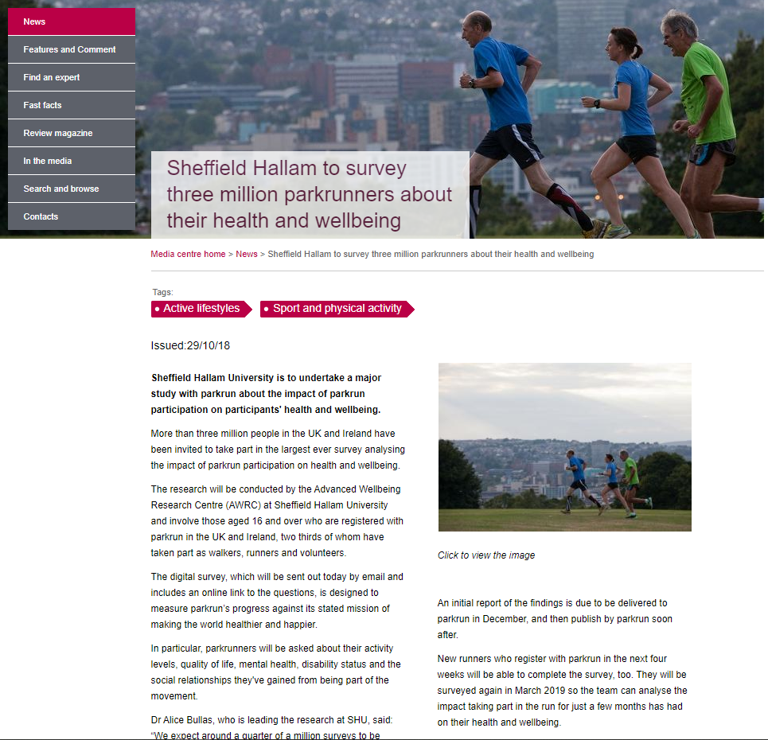
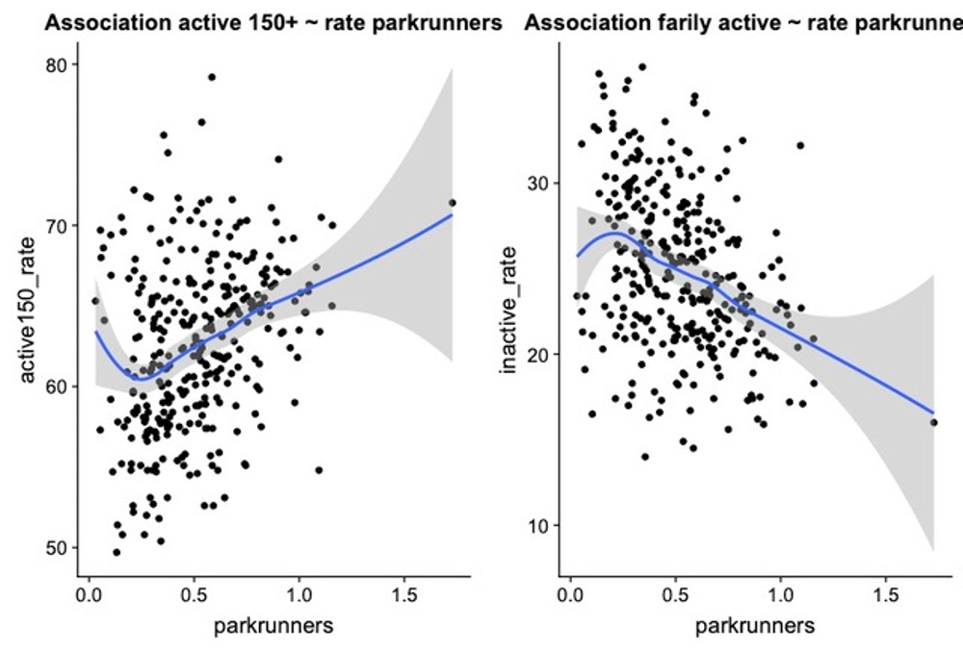
Further Research
International Replication
Economic Model
Wider Impact

Slide 23

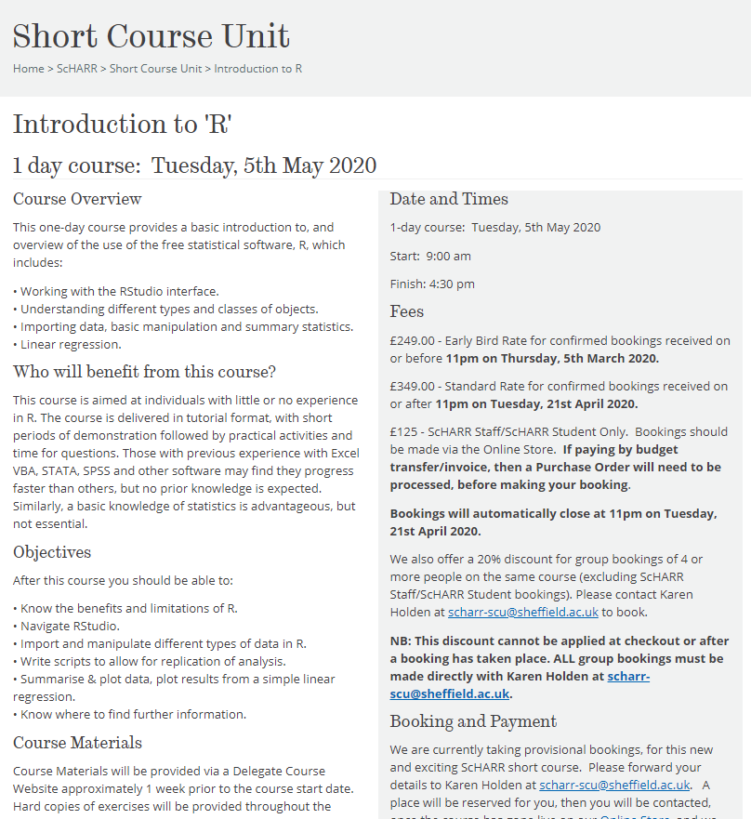

Open research & programming
https://github.com/bitowaqr/DoPE
https://www.sheffield.ac.uk/scharr/shortcourseunit/intror

